Slide 1
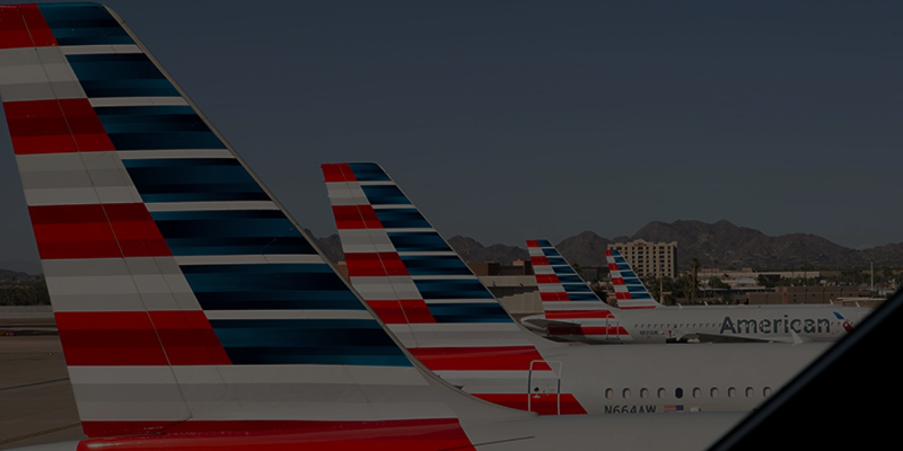

MIS 6349 – Digital Consulting Project

Slide 2

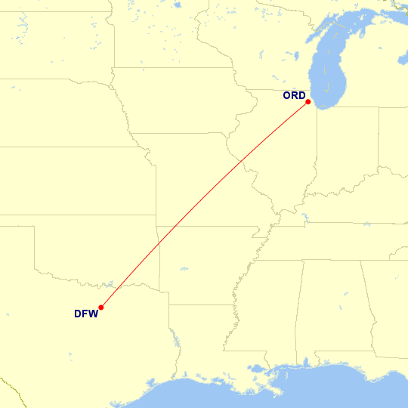
Agenda
1
Analyzing the tickets prices using the summer 2022 DDS data.
2
Coming up with the best recommendations to maximize revenue for American Airlines
3
Conclusions

Slide 3

Executive Summary
Problem Statement
Analysis
Result
By utilizing data visualization techniques to analyze real-time market trends and QSI data
AA can respond quickly to changes in demand and remain competitive in the marketplace.
American Airlines (AA) aims to assess its competitiveness in relation to route, selling price, and schedule to maintain its market share.
AA seeks opportunities to become price competitive while remaining a market leader by improving their performance day by day in the airline industry.
We believe, taking a look at customer preferences to flight timings and seasonality changes will help AA understand why it did not meet its forecasted market share and increase 10% of AA’s revenue.

Slide 4




O&D Reason
Dallas and Chicago's economic significance could generate high air travel demand between them.
DFW and ORD's proximity enables quick, convenient air travel.
Maintaining market share and competitiveness by serving a route with existing competition.
Being hub airports can offer convenient connecting flights to other destinations.
Notes:
Economic centers: Dallas and Chicago are both major economic centers with many Fortune 500 companies, which could lead to a high demand for air travel between the two cities.
Hub airports: DFW and ORD are hub airports for American Airlines, which means that there are many connecting flights available to other destinations, which can increase the convenience for passengers.
Geographical proximity: DFW and ORD are relatively close to each other geographically, which means that the flight time between the two airports is relatively short, which can be attractive to passengers looking for quick and convenient travel options.
Competition: Other airlines offer flights between DFW and ORD, so American Airlines may want to maintain its market share on this route to stay competitive.

Slide 5
Market Share
American Airlines has the highest market share among all carriers, as indicated by the QSI market share, which reflects the overall demand for each airline in the market.
90%
American Airlines
This airline holds the largest market share and revenue for the given origin and destination (O&D).
Other.
The revenue for airlines such as WN, B6, and others is less than 20%.
20%
50%
86%
Delta Airways
The airline is currently ranked third in terms of market share.
United Airways
They have the second-highest revenue, but their prices are comparatively high.

Slide 6
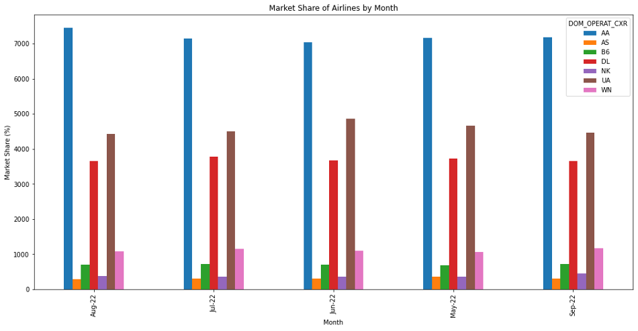
Forecasted Market Share
American Airlnes

Slide 7
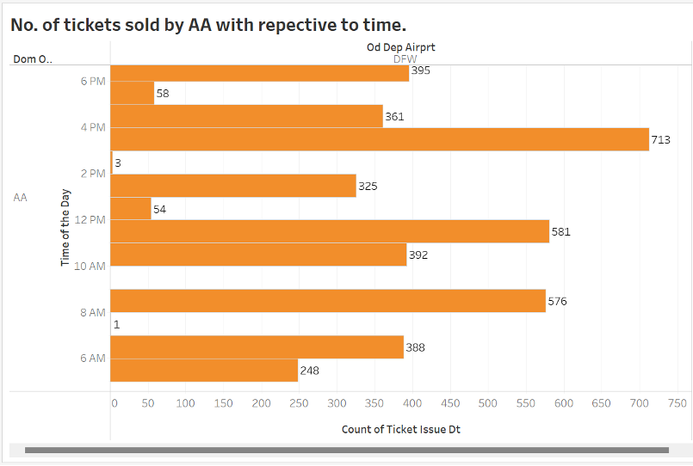
Ticket Sales by Departure Time for a Given O&D: Graph Analysis
Least number of travelers on DFW-ORD route from 12pm-2pm due to business and technology industry schedules.
American Airlines should adjust flight schedules to better accommodate these industries and optimize their resources.

Slide 8
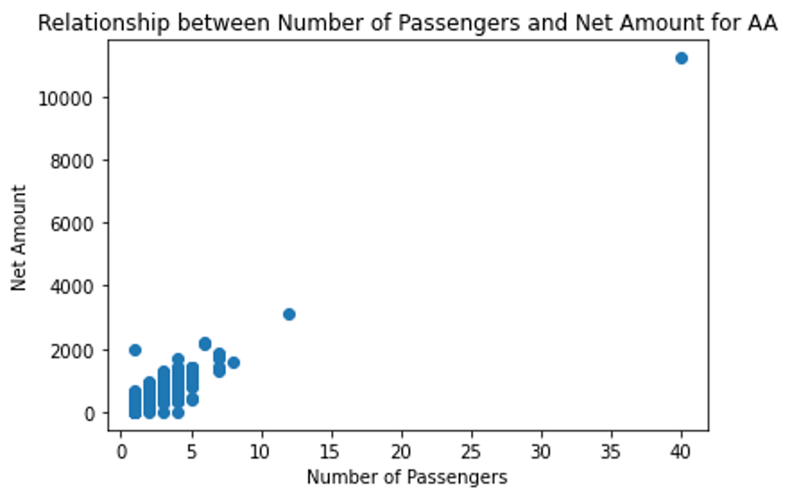
The Relationship Between Passengers and Net Amount for AA Flights: Analysis
Implement strategies to increase passenger count and incentivize booking with AA.
Develop tactics to attract customers away from competitors and gain 10% increase in market share.

Slide 9
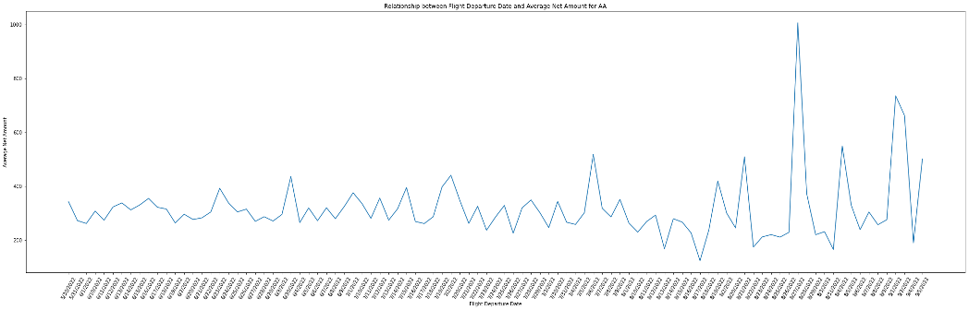
Flight Departure Date vs. Net Amount for AA Flights: Analyzing Patterns and Trends to Increase Revenue
Increase flight frequency during high-demand periods (August/September) to capture more revenue
Consider raising ticket prices during peak demand times (end of June) to maximize profits.

Slide 10
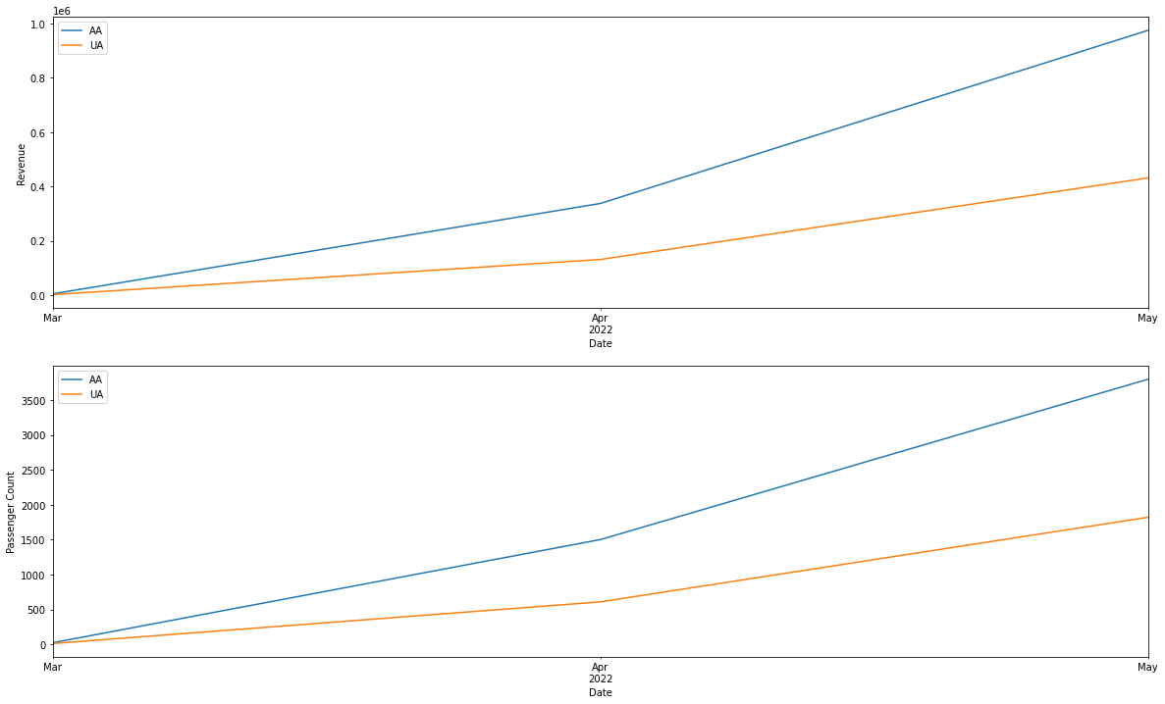
Analysis of Revenue and Passenger Count Trends for American Airlines, Delta Airlines, and United Airlines
American Airlines had the highest revenue and passenger count among three airlines from mid-2021 to mid-2022.
Seasonal patterns exist in revenue and passenger count trends, with a peak in summer months and a trough in winter months, and AA had the highest peak and lowest trough among the three airlines

Slide 11
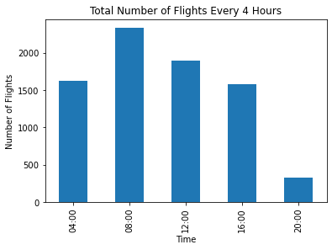
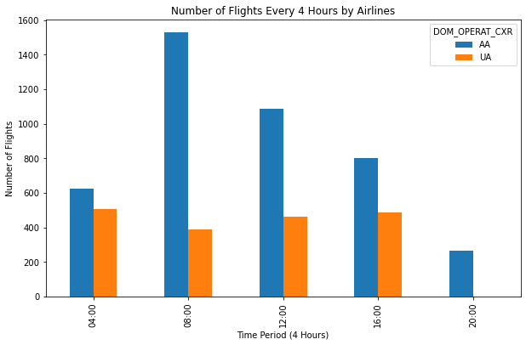

Slide 12
Seasonal patterns exist in revenue and passenger count trends, with a peak in summer months. AA had the highest peak and lowest trough among the three airlines
AA should adjust their flight schedule to decrease the number of flights from 12pm-2pm due to the low demand volume and focus on increasing flight volumes during high traffic times such as 4-6pm
AA could consider increasing the ticket prices for flights departing towards the end of June to capitalize on the higher demand
AA should develop tactics to increase passenger count and attract customers away from competitors gaining 10% increase in market share
Summary

